Slide 1
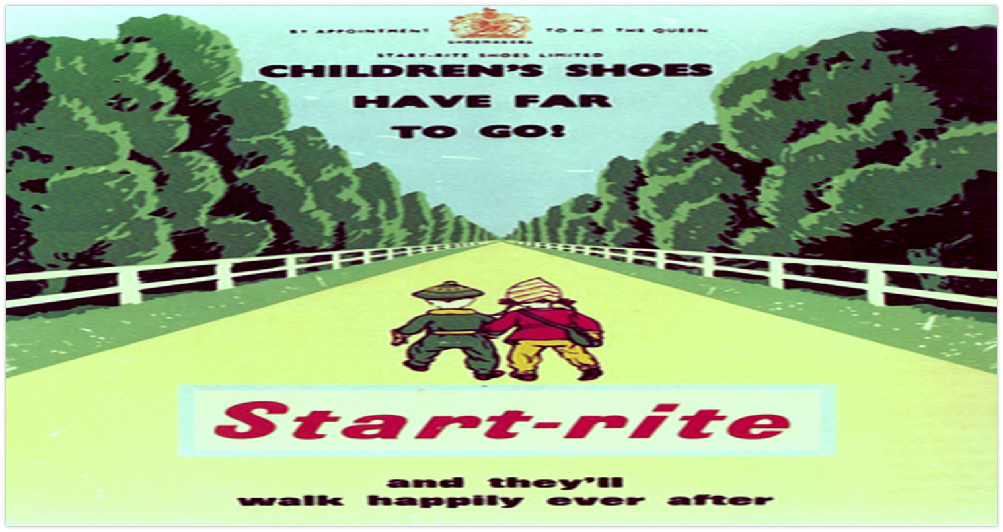
TUESDAY PATHWAYS
ART 2/3
CAFÉ/FOOD TECH
2/3
HOSPITALITY/RETAIL
2/3
HORTICULTURE
2/3
Year 8 to Year 14
DRAMA
2/3
SPORTS’ COACHING
2/3
COOKING/CAFÉ
1/2
HOSPITALITY/RETAIL
2
ANIMAL CARE
2/3

Slide 2
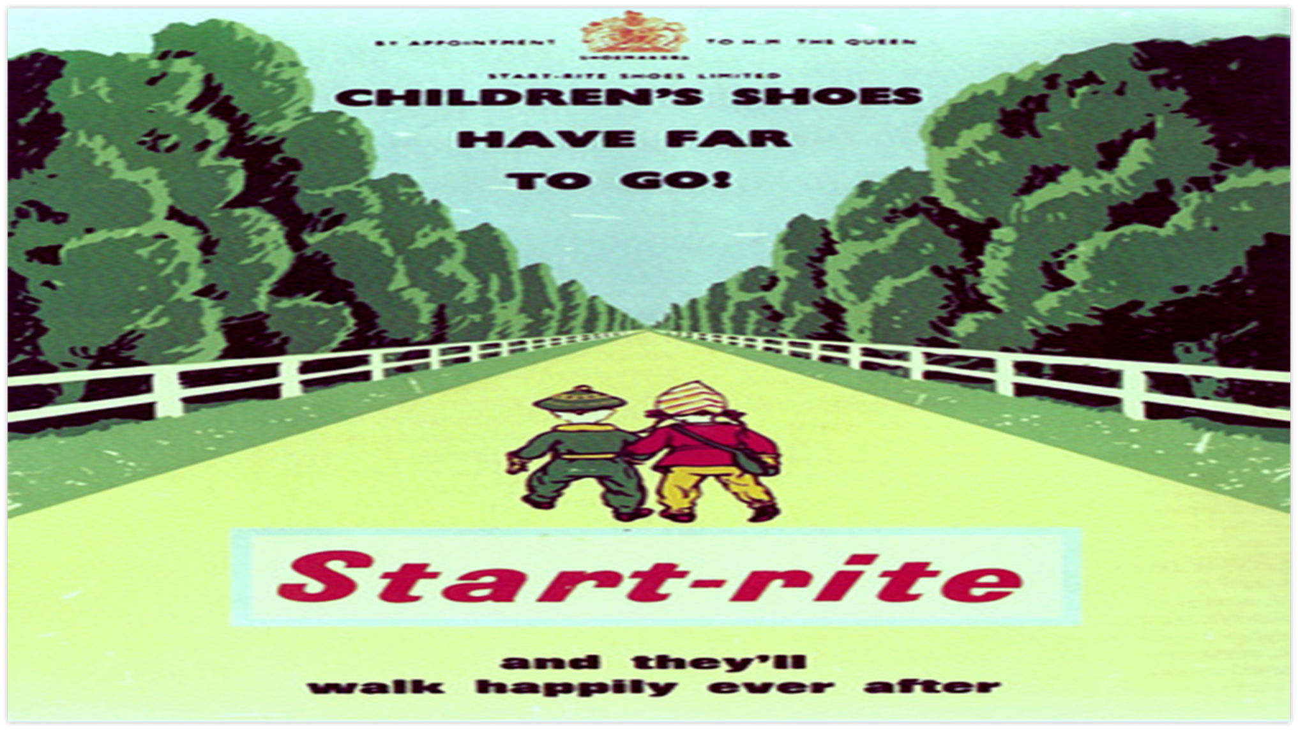
THURSDAY PATHWAYS
ART 2/3
CAFÉ/FOOD TECH
2/3
Estates Management
2/3
HORTICULTURE
2/3
Year 8 to Year 14
Drama
2/3
SPORTS’ COACHJING
2/3
SPORTS’ COACHING
2
HOSPITALITY/RETAIL
2
ANIMAL CARE
2/3

Slide 3
LEARNING VOYAGES
Learning journey voyage
Bakerloo/Transition
Early pathway Experience
Learning journey voyage
Learning journey voyage
Learning journey voyage

Slide 4

Oaktree School Learning Journeys
Journey 1/Voyages
Journey 2
Journey 3
Confident Community Engagement (Sensory + Concrete learning experiences) Learning through the senses and learning through doing | Community Engagement and Employment Opportunities (Concrete + Abstract learning experiences curriculum) Learning through doing and acquiring knowledge | Further Study and Skilled Work Opportunities (Mid to top MLD) knowledge + skills-based learning experiences
Learning Journey 1 supports students to live as independently as possible and to enjoy accessing their community confidently according to their individual strengths. | Learning Journey 2 supports students to look at a variety of pathways after they leave Oaktree school. They will have the opportunity to access a wide variety of jobs including catering and hospitality. | Learning Journey 3 supports students by providing them access to a variety of assessments in order to lead them to their career of choice. This can include GCSE with the support of local mainstream schools.
All students will have access to the on-site Café, this will provide a “Dress Rehearsal” to build on Social Skills and Work skills.
OCR: Life and Living skills (OCR) | OCR/Assessments: Life and Living skills (OCR), Signs and symbols in the community, Functional skills Entry Level 1,2 and 3 in Maths and English | OCR/Assessments: Life and Living skills (OCR), Functional Skills Level 1 in Maths and English
Early Communication Total communication supported by objects of reference, social sight vocabulary, Makaton. Familiar signs and symbols within the community. Focus on listening, attention and understanding as well as experiencing multi-sensory stories. | Communication and Literacy Functional literacy including the use of signs and symbols within the community and a clear focus on communication and understanding. Early stages of reading and writing supported by the See & Learn approach or phonics as well as engaging and diverse texts.. | Communication and Literacy English lessons have a focus on longer, age-appropriate and diverse texts that students can derive enjoyment from. Reading taught through the See & Learn approach or phonics. Learning to read evolves into reading to learn. Students encouraged to read for pleasure.
Exploring and understanding the World/Numbers in the World Recognising numbers, money awareness, concept of time | Numeracy Functional Numeracy in everyday life, Maths lessons including data and number/financial education | Numeracy Maths lessons including Geometry, measure, data and number/financial education
Physical Development P.E, Swimming, Dance, Yoga, Physical Therapy, Occupational Therapy, Sensory experiences, | Physical Development P.E, Swimming, Dance, Yoga, Physical Therapy, Occupational Therapy | Physical Development P.E, Swimming, Dance, Yoga, Physical Therapy, Occupational Therapy
Personal, Social and Emotional Development Preparation For Adulthood: Independent Living, Health, Friends, Relationships and Sex Education, Relationship and the community, self confidence and self awareness, health and self care | Personal, Social and Emotional Development Preparation For Adulthood: Employment, Independent Living, Health, Friends,Relationships and Sex Education, Relationship and the community | Personal, Social and Emotional Development Preparation For Adulthood: Employment, Independent Living, Health, Friends, Relationships and Sex Education, Relationship and the community
Enrichment Music, Art, Dance, Pathways, Trips | Enrichment Music, Art, Dance, Pathways, Trips | Enrichment Music, Art, Dance,Pathways, Trips
Living and Leisure Work experience, shopping, Cooking, Independent living, Out and about, Café in and out of school, horticulture | Life and Living Skills Careers Education/work placements Independent living skills, Café in and out of school Travel training, Agriculture support, Trade | Life and Living Skills Careers Education/work placements Independent living skills, Café in and out of school, Travel training, Horticulture, Trade

